Slide 1

Healthcare Analysis

Slide 2
Introduction to Healthcare Analysis
Healthcare analysis is the process of examining data and information in the healthcare industry to gain insights and make informed decisions.
It involves analyzing healthcare data to identify trends, patterns, and correlations in patient outcomes, resource utilization, and healthcare costs.
By conducting healthcare analysis, organizations can improve decision-making, monitor performance and quality, and support evidence-based practices in healthcare.

Slide 3
Data Sources of Healthcare Analysis
Healthcare analysis relies on various data sources to gather information and derive insights. Here are some common data sources used in healthcare analysis:
Patient Id
Appointment ID
Scheduled Day
Appointment Day
Hypertension
Diabetes
Alcoholism
No-show

Slide 4
Key metrics of healthcare analysis
Patient Satisfaction:- Measures the level of satisfaction or dissatisfaction among patients regarding their healthcare experience, including quality of care, communication, and accessibility.
Resource Utilization:- Tracks the utilization of healthcare resources, such as hospital beds, surgical procedures, diagnostic tests, and medications, to assess efficiency and cost-effectiveness.
Financial Performance:- Evaluates financial indicators, such as revenue, expenses, profitability, and return on investment, to understand the financial health and sustainability of healthcare organizations.
Wait Times:- Measures the time patients wait for appointments, procedures, or emergency care, which can impact access and patient satisfaction.
Healthcare Access:- Tracks indicators related to access to healthcare services, such as the number of primary care providers, healthcare facilities, and insurance coverage rates.

Slide 5
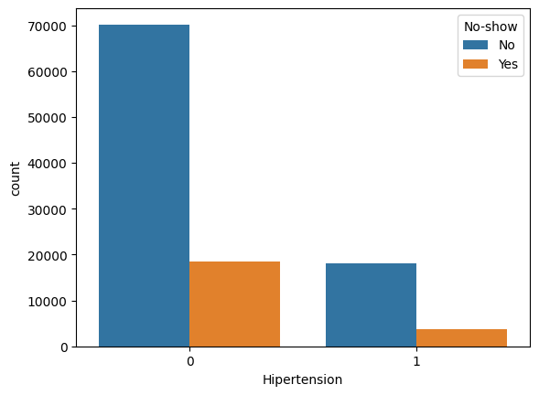
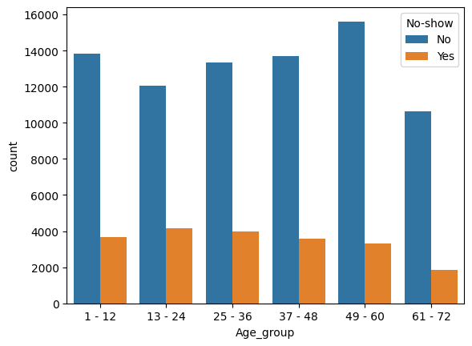
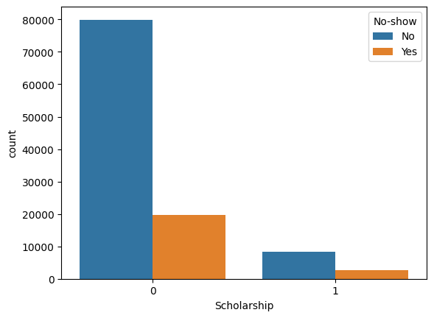
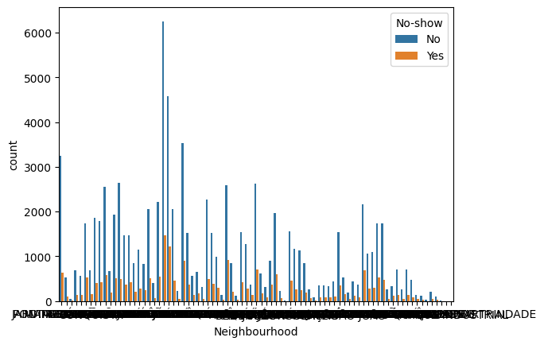
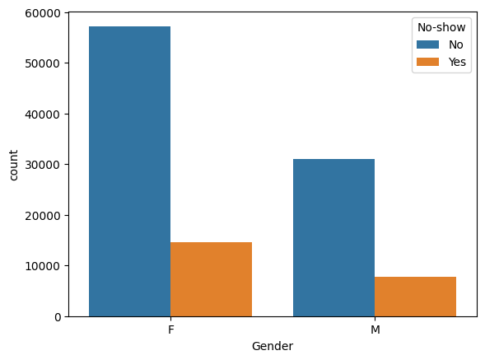
Univariate Analysis
Female patients took more appointment than Male patient. But, No-Show rate is equal for Male and Female patients.
Age group (13-24 years) had highest No-Show, around 26% rate.
People who don't have Scholarship have 24% No-Show rate for appointments.
84% of patients who did not receive SMS reminders attended their appointments, while approximately 73% of patients who received SMS reminders did not attend their scheduled visits.

Slide 6
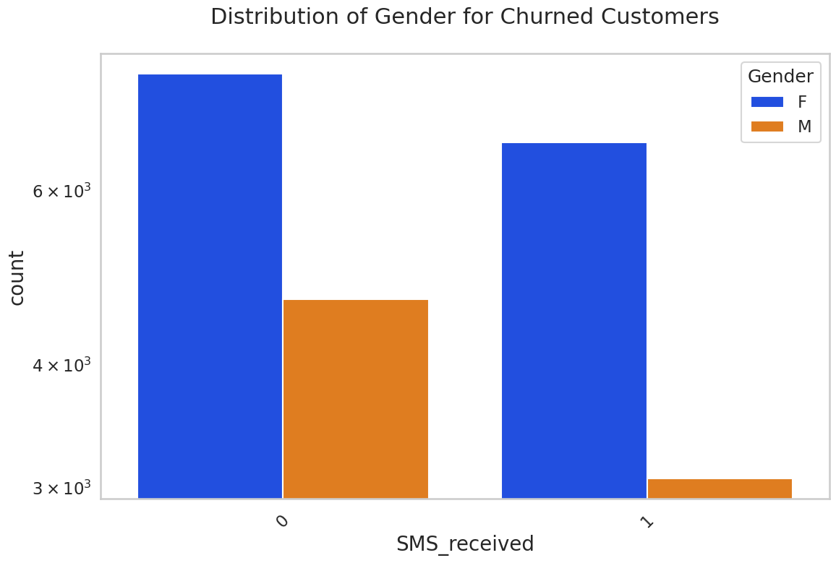
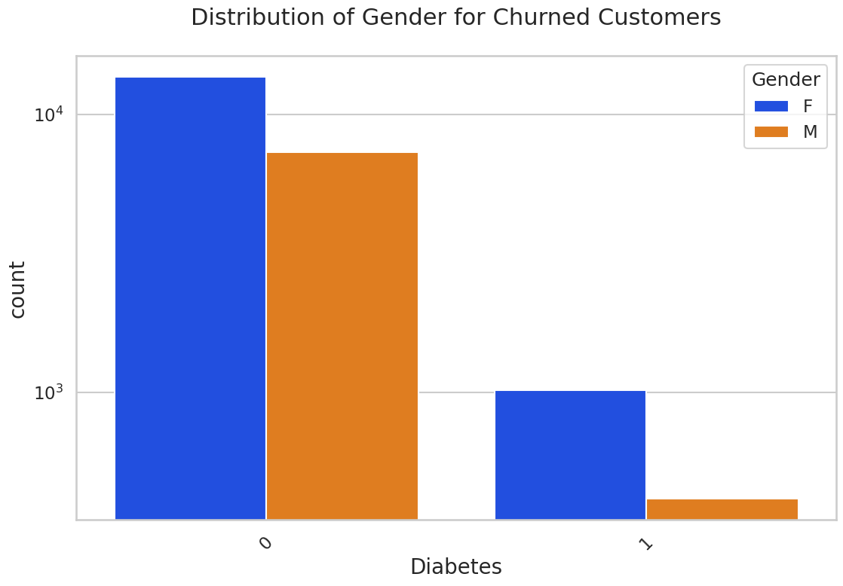
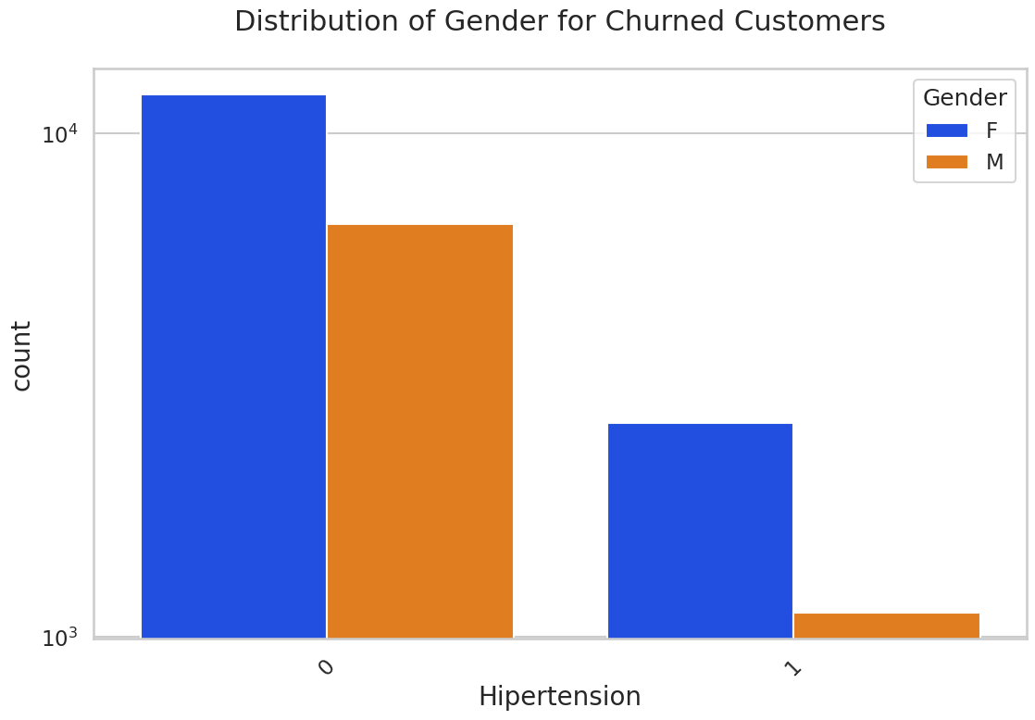
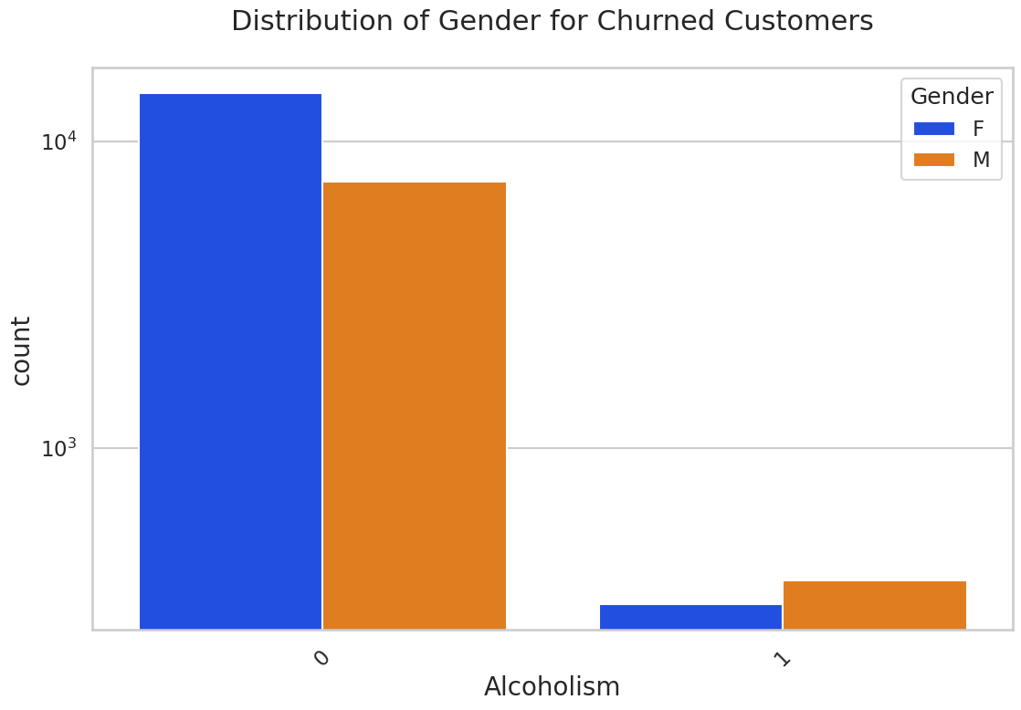
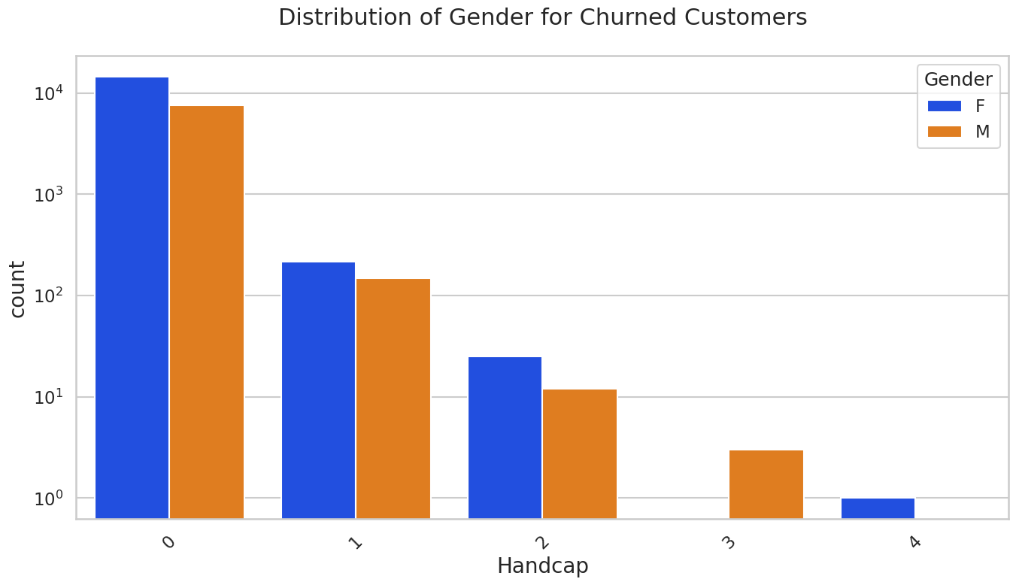
Bivariate Analysis
Bivariate analysis in healthcare involves examining the relationship between two variables in healthcare data. It helps to understand how changes in one variable are related to changes in another variable. This analysis can be done using statistical methods. Bivariate analysis provides insights into factors influencing health outcomes and informs decision-making in the healthcare field.

Slide 7
The challenges of healthcare analysis include:
Data quality and standardization: Healthcare data is often stored in different formats and lacks standardization, making it difficult to acquire and cleanse the data for analysis. Inaccurate or incomplete data can lead to biased or unreliable results.
Data privacy and security: Healthcare data contains sensitive and personal information, and ensuring data privacy and security is crucial. Compliance with regulatory requirements, such as HIPAA in the United States, adds complexity to data analysis while protecting patient confidentiality.

Slide 8
Analytical skills and expertise: Healthcare analysis requires a combination of domain knowledge, statistical expertise, and data science skills. The shortage of skilled analysts and data scientists in the healthcare industry can hinder effective data analysis.
Ethical considerations: Healthcare analysis involves handling sensitive patient information and making decisions that impact patient care. Ensuring ethical use of data, avoiding bias, and maintaining transparency are important considerations in healthcare analysis.

Slide 9
CONCLUSION
Data is highly imbalanced 80:20
Female patients took more appointment then male patients.
noshow rate is high in female patients then the male patients.
Age group(13-24 years) had highest noshow, around 26% noshow rate.
Out of a total of 21,801 hypertension patients, 3,772 patients have not attended their appointments, around 17% noshow rate
73% of patients who received SMS reminders attended their appointments. Among these, female patients had a higher no-show rate compared to male patients.
Female patients no show rate is high in case of scholarship and hypertension.

